Slide 1

Store Leader Daily Workload Management
Survey Summary
Target UX Research
April 2025
Julie Coffman

Slide 2
Survey Overview
Goal
Distribution
Process
To establish a baseline and measure progress following the launch and development of the holistic workload visibility leader dashboard of time spent, perception of ease, and confidence of decisions by leaders assessing and prioritizing daily workload.
The survey was open to the store leaders invited to participate from April 1-8, 2025. The survey was distributed to 1,642 stores. SDs received an invitation to the survey in their email and ETLs and TLs received the invitation within myDay.
The Task Management Product Team (with the UX Researcher and Store Ops Business partner) worked with Corporate Communications and HR to review the survey, provide feedback, and draft the survey invitation.

Slide 3
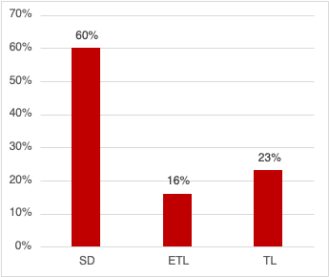
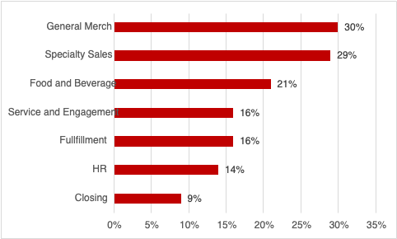
694 Store Leaders Represented
416
115
163
Work Areas for ETLs and TLs only
Notes:
With approximately 9,905 ETLs and a sample size of 115 in this survey, we have a 9% margin of error at a 95% confidence level.
With approximately 23,772 TLs and a sample of 163 in this survey, we have a 8% margin of error at a 95% confidence level.
With 1,981 SDs and sample size of 416 in this survey, we have a 4% margin of error at a 95% confidence level.

Slide 4
For this survey, when we say “assessing and prioritizing daily workload” we mean the time you spend assessing and prioritizing what needs to be done by the team on the floor and/or the backroom on any given day. This could mean assessing store brand, looking at trailer break out, writing daily assignment sheets, reading closing notes, reviewing relevant dashboards and reports, etc. when you arrive or throughout the day. This does not include tasks like weekly workload planning, writing work schedules, etc.
Notes:
UXR Style Guide Deck - 2024.pptx

Slide 5
Store Leaders currently spend on average 87 minutes a day assessing and prioritizing daily workload.
With the minimum being 1 minute,
the maximum reported being 540 minutes (9 hours),
And the mode being 60 minutes a day.
SDs spend on average 103 minutes a day,
ETLs spend on average 76 minutes a day,
And TLs spend on average 44 minutes a day
Assessing and prioritizing daily workload.
Notes:
UXR Style Guide Deck - 2024.pptx

Slide 6
Store Leaders currently spend on average 9.2 hours a week assessing and prioritizing daily workload.
With the minimum being half an hour,
the maximum reported being 60 hours,
And the mode being 5 hours a week.
SDs spend on average 10.8 hours a week,
ETLs spend on average 8.7 hours a week,
And TLs spend on average 4.6 hours a week
Assessing and prioritizing daily workload.
Napkin math:
10.8 x 1 (# of SDs/store)
8.7 x 5 (avg # of ETLs/store)
+ 4.6 x 12 (avg # of TLs/store)
____________________
Approx. 109.5 hrs / week / store
Notes:
10.8 (1) + 8.7 (5) + 4.6 (12) = 109.5 hrs / week / store
(average leader counts per store)

Slide 7
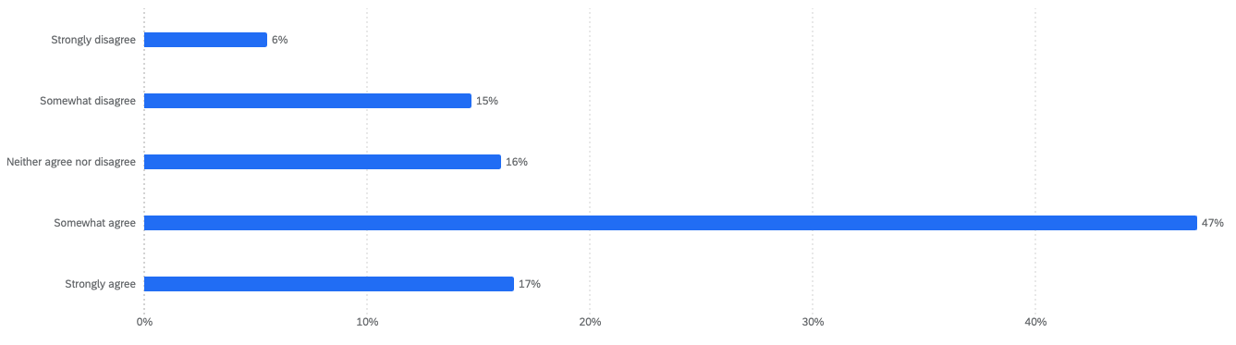
The current process for assessing and prioritizing daily workload is effective and meets my needs.
37% neutral or disagree
64% somewhat or strongly agree
Notes:
UXR Style Guide Deck - 2024.pptx

Slide 8
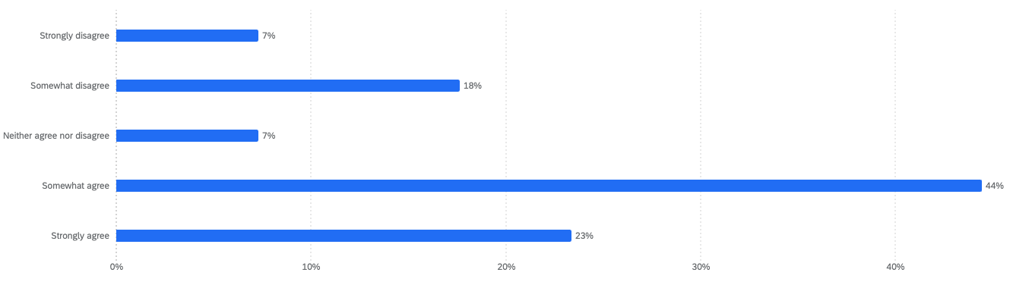
I can easily see all the necessary information I need to assess and prioritize my daily workload.
32% neutral or disagree
67% somewhat or strongly agree
Notes:
UXR Style Guide Deck - 2024.pptx

Slide 9
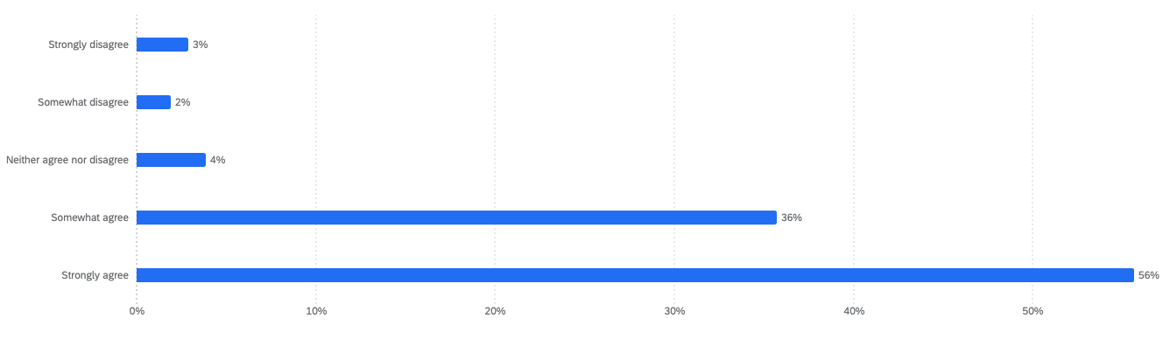
I am confident in the decisions I make when assessing and prioritizing daily workload.
9% neutral or disagree
92% somewhat or strongly agree

Slide 10
What else, if anything, would you like to share with us about daily workload planning?
Working with Incomplete Data
Navigating Too Many Tools
Is challenging when making workload decisions because of inconsistent data, lack of data for critical processes like truck deliveries, and data that’s not available in time to make informed decisions.
As a leader is not only overwhelming but also takes extra time to log-in to separate tools, synthesize all the different data streams, and teach new leaders how to use all the tools. Leaders specifically expressed a desire for a centralized report of all the necessary data and priorities needed for daily workload planning.
73 mentions
45 mentions
Time Management
Device Inconsistencies
Is challenging as a leader, and daily workload planning is a clear example when leaders want to take the time to make strong, data-informed decisions but are being pulled in many directions. It is challenging to lead at the right level when there is not enough time to get a full picture of the daily workload.
Are another frustrating aspect of the current experience as leaders navigate dashboards on a computer (if they have access to one), data available on their myDevice, notes and spreadsheets from other leaders, and daily paper assignment sheets. It is especially challenging to make informed decisions and communicate those changes throughout the day given the current devices used.
39 mentions
27 mentions

Slide 11
Working with Incomplete Data
“Numbers don’t match from greenfield and MPM, hard to tell my team (and myself) which one to use. Pricing forecasts are not accurate for all stores, hard to plan. MPM should match greenfield better with titles and grouping of reporting. Everything should be in a one stop shop. Health dashboard is good but could be better, have more on there or links to the side for digging further. Doesn’t go deep enough.”
“Some reports like Priority Fill and Inventory Audits do not populate early. For being GM-based areas, and GM leaders are typically in the building by 6am or earlier, it would be beneficial to have these reports ready for them at 6am. Also, easier access to see truck fill data - and include estimated time when trailer will close if this information is available.”
“The reporting is there, but inaccurate frequently. Trucks will say you are getting 2 repacks for Home, but you get 36. Or you are getting 100 diapers and you get 200. This then makes the push times inaccurate as well. The hours given for workload do not line up either. Price change hours are not reflected. Pogs say they will take 6 hours, but take 20. The hours do not change on inbound if you have 5 or 7 trucks that week.”
“The way fullfillment drops in makes it impossible to plan your daily workload. If the company is behind in orders then you get your workload up front, if the company is caught up, you may not get all your work till after you leave. There needs to be reasonable cut times so you can plan.”
Notes:
UXR Style Guide Deck - 2024.pptx

Slide 12
Navigating Too Many Tools
"Tools provided are usually very helpful, but I have to log into 3 different apps multiple times a day... just troubleshooting why I can't get logged in or having to re-log in...”
"Most data I need to assess business is spread over many different reports... Some reports are not useful for business growth and focus too much on minor metrics.”
"Having a completion trend indicator on the main screen of the 'current work' tab would be extremely helpful in spot checking daily vs weekly performance..."
"We need more data at our fingertips that's easy to glance and digest... the more I can have a quick look that tells me what and how fast my team is doing work, the better.”
"Daily planning requires too many different data sources... Greenfield, MPM, and myDay all play a role."
Notes:
UXR Style Guide Deck - 2024.pptx

Slide 13
Time Management
“Team Leaders should be able to have more time away from workload and be able to spend time planning and assessing their business. Team Leaders make the most in the moment/Live decisions for the business as they lead their teams. They should be able to have the time to go through everything they would need to start/finish their days without being a part of the workload.”
"Daily assignment sheets... could be more intuitive. It still feels like a lot of gathering and writing to get to the assessment and plan execution.”
“We get a lot of information - whether from HQ, leadership, or team. It forces the feeling of replying to emails and reading information when not in store to have uninterrupted time to designated to the workload planning process. For example, it is 11:55pm on a Monday night but it was the only time to get through the entirety of my inbox after my kids when to bed and before I go to my store from 7am-5pm.”
“In order to be successful, communication and teaching are paramount. As my Leadership team has improved, my personal time spent daily assessing, etc has decreased as they are already a step ahead of me. This allows me to spend more time in personal, professional developmental tasks with the team.”
Notes:
UXR Style Guide Deck - 2024.pptx

Slide 14
Device Inconsistencies
"It is literally impossible to put every single thing a TM needs to complete onto an assignment sheet.”
“We need tablets to access Greenfield reports on the go, my devices is to hard to read reports and if you print them takes a lot paper.”
“It would make more sense if there was a way for my day to automatically be associated with the tasks directed for that team member by day. (For example have them only signed into pulls for the area you wanted them to be working.) Or have notes directly in a greeting message for special tasks etc.”
“Wish I had access to all data on my cellphone just like etls. It streamlines data and ease of access while I walk the floor to remove hurdles for closing teams.”
“The main dashboard doesn't always load quickly and efficiently throughout the day. I spend a lot of time waiting for pages to load or having to sign out and sign back in in order to get to the page I need faster to compile the information I'll need to get task work done.”
Notes:
UXR Style Guide Deck - 2024.pptx

Slide 15
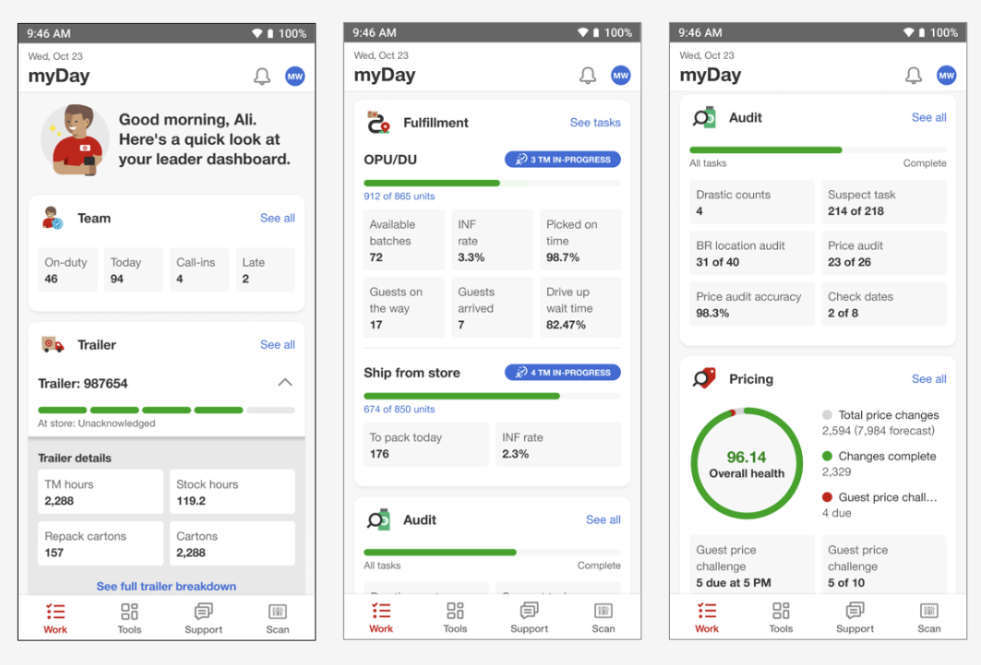
So what?
The primary goal of this survey was to establish a baseline for how long leaders are currently spending prioritizing and assessing daily workload and how they feel about their current experience. The findings from this survey give us the first look chainwide at our opportunity for time saved with the new leader dashboard and validates our task management problem statement.
Problem Statement: As a leader, I strive to manage payroll as efficiently as possible, but I lack holistic, real-time insights into both my daily workload and how it aligns with my allocated payroll. This lack of visibility and decision-making support results in inefficiencies, team frustration, and decreased motivation, ultimately leading to poor workload prioritization and missed critical tasks.
The new leader dashboard will be launching to the entire chain on May 7, 2025.
Notes:
UXR Style Guide Deck - 2024.pptx

Slide 16
What’s next?
Current proposal is that this same survey would be shared with the same audience in the fall of 2025, after all leaders have access to the new myDay leader dashboard, and then potentially again in spring 2026.
We can consider adding a few new questions to the next survey specifically how the new leader dashboard has changed their experience.
We will also continue to collect qualitative feedback directly from store leaders via interviews and feedback calls as well as monitor behavioral usage data.
Want more?
Leader Survey Open Ends_April 2025.xlsx

Slide 17
Appendix
Target UX Research
Date (Month / Year)
Team Members

Slide 18
Research Plan
Task Management Leader Survey.docx
Communication Plan
2025_04.01 WFM_Task Management Leader Tools Survey Communication Plan.docx
Notes:
UXR Style Guide Deck - 2024.pptx

